Slide 1

Growing OnFinance User Base
ProduScope 22 entry – Chinmay mathur

Slide 2
Executive Summary
User Persona: Late teens – early twenties, other new amateur investors
Pain points: Lack of knowledge, Looks more like a news app, No way to import stocks portfolio (only crypto), Uses third party applications for transactions, No web app
Possible new features: Simpler UX to show likely impact of news in a single glance, Integration of stocks and crypto transactions from the app itself, Revamp of web based service instead of forcing user to download app
KPIs: Number of new portfolios imported per day, Number of transactions redirected from OnFinance per day, Number of daily active users,
GTM: Audience is early twenties due to high global exposure and incentives for investing, Value proposition: Predicting market trend using AI based on latest news helping people make good investments, Pricing: Transaction fee, freemium model for restricted and detailed reports – advanced tools for experienced investors, Distribution: internet and telemarketing giving free access to premium for 1 week

Slide 3
User Persona
Old investors
College Students
Young Professionals
Ages: 40 +
Goal: Find easier and less riskier way to predict new market trends
Pain Point: Less understanding of latest technology, less ease to operate multiple apps for single purpose.
Solution: Integrate transactions and open web based services also importing stocks portfolios
Ages: 18 – 24
Goal: To keep money invested for growth, uses the app to minimize taking risks
Pain Point: Less time and money, need a quick summary where to invest to maximize profits
Solution: Give a one-glance summary of the impact
Ages: 24 - 40
Goal: Learn about investing and invest their savings
Pain Point: Lack of understanding about impact of news and feel complicated to use various apps
Solution: Integrate transactions and simplify predictions of news

Slide 4
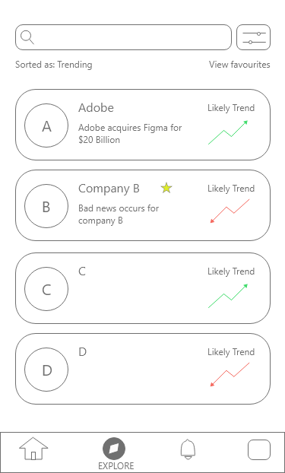
Feature #1: Convenience – Indicators & UX
The UI can show the predications based on news along the side example: Adobe buys Figma as a result, value of Adobe should increase showing an upward trend. Further sorting option in categories for trending, latest, greatest increase, greatest decrease would be helpful.
This feature increases engagement as more people will find it helpful and simple to use. This will also increase userbase via referrals which can have additional rewards.
This feature will ensure increasing daily active users.
DETAILS
DETAILS
DETAILS
DETAILS
Lo-fi Wireframe

Slide 5
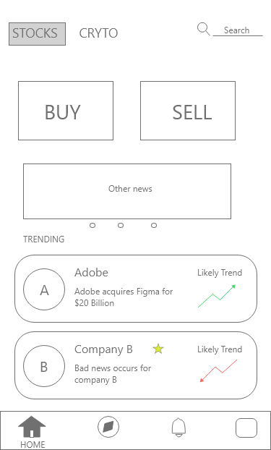
Feature #2: Adding Transactions
Adding transactions, i.e. buying and selling of stocks and crypto from the app itself instead of re-directing to other applications.
This feature converts the app to one stop solution for investors new and small scale investors. Before investing they can analyse the news and make decisions according to the market analysis provided by the app without getting redirected.
This integration will disrupt other investing applications since they rely on user having enough market understanding while OnFinance gives an opportunity to learn while investing as it minimizes risk.
This feature is aimed at acquisition and retention, as more people will invest knowing there is a lower risk involved while viewing the detailed analysis
Lo-fi Wireframe

Slide 6
Feature #3: Web app
This feature is targeted at increasing the reach and promoting the app, web app can act as a transition to the app or a trial mechanism. Many people may not prefer repeatedly seeing the phone or a desktop app but simply keeping a tab open.
This feature is aimed at acquisition
Feature #4: Trading lectures
This feature uses several finance creators to teach about trading on this platform. This features mainly targets engagement and retention as users can learn trading while having knowledge of market trends

Slide 7
Prioritization and Effectiveness
Using rice framework
Feature | Reach (new number/ month) | Impact (1= lowest, 5 = highest) | Confidence (percentage) | Effort (time required per person per month) | Total RICE Score (RIC/100E)
Simpler indicators | 1000 | 3 | 90 | 3 | 900
Integrating transactions | 2000 | 4 | 95 | 7 | 1085
Web app | 750 | 2 | 70 | 2 | 525
Trading Lectures | 500 | 2 | 80 | 2 | 400
Hence we can say integrating transactions will give us maximum advantage and should be prioritized over other features

Slide 8
Go-to-market strategy
Target market | Marketing strategy | Pricing strategy | Sales strategy | Customer support | metrics | Product fit
Early twenties is time where we want to take risk, catering to this audience will help them gain financial knowledge as well | USP of market predictions must be advertised as distinguishing factor | Pricing shall be done in a freemium manner, the app is free to use. | Online promotions is the strategy, showing the risks involved in trading and how OnFinance can minimize it. | Customer support with good banking and trading knowledge is required | Number of transactions through OnFinance is the KPIs, it indicates the user growth and measures retention | By integrating trading, the product can become independent for investors
Late 40s, time when thinking about retiring and investing money, OnFinance can assist in determining how safe it is to invest | Online marketing and finance creator sponsorships are way to attract attention since target audience tend to spend more time and get influenced by these methods | Premium features would include option to have early access to news, detailed interpretation and recommending on which stocks or crypto to buy. This model may include stages of pricing. | Training and trading masterclasses can also be conducted to publicize the product and let users get familiar with it | Implementing trading will require a huge customer support, increase in user base will lead to great technical support due to greater engagement occurring | Number of portoflios imported and number of daily active users are also important indicating activation and retention. New signups indicates acquisition | Without it, the platform services as a pre-requisite and complement to other trading apps

Slide 9
THANK YOU
Chinmay mathur
Team: regal

Slide 10
Bibliography
https://play.google.com/store/apps/details?id=com.onfinance.app
onfinance.in
https://theproductcompany.com/gtm-strategy-examples/
google

